Slide 1

Functions in Python
MTH 564 – Mathematical Modeling

Slide 2

Installation of Python
Functions in Python
def function_name(parameter1, parameter2, ….):
statement 1
statement 2
…..
def keyword that tells Python you are starting a function definition
function_name should be lowercase with words separated by underscores
- can start with letters or underscore
- can contain numbers
parameter same naming rules as variables
The : and indentation are very important - indentation tells you want commands are executed when you call the function
Example: functions.py

Slide 3
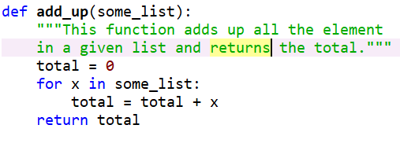
Example: add_up
Notes
The variable total only exist inside the function
The return keyword tells Python to send a value back to the caller.
Nothing “inside” this function gets executed until you call the function with the statement: add_up(…)
Example:
function.py

Slide 4
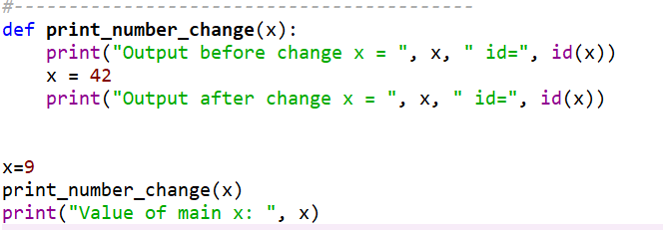
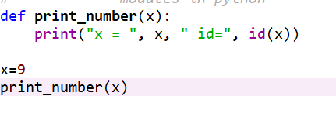
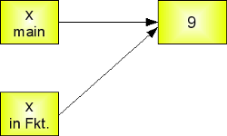
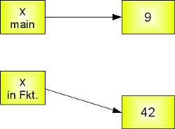
Installation of Python
Variable Passing by Reference
Call by Object Reference (Technical Name)
At first all parameter’s passed to a function are passed by reference
That is, they simply point to the same play in memory
The changes that can occur to a variable (parameter) passed to a function depend on if the object is mutable or immutable.
Example: functions.py

Slide 5
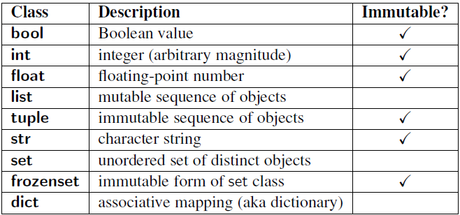
Installation of Python
Mutable versus Immutable
Mutable – can be changed after creation
Immutable – cannot be changed after creation
Example:
x = 9
…
x = 42
# x points
# to a new
# memory
# location

Slide 6
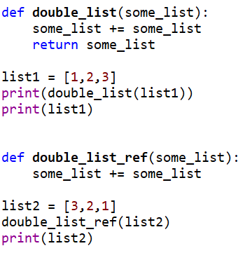
Installation of Python
Mutable Example
Consider the example on the right:
List are mutable
They can be changed
Both these have the same result
The return statement on the first function is superfluous
Example: functions.py
Notes:
Draw picture on board with memory locations

Slide 7
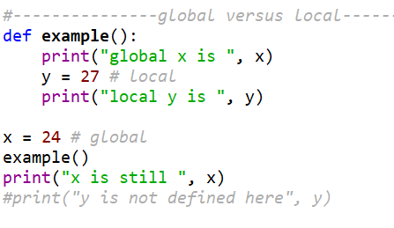
Installation of Python
Global versus Local
Local – these variables only exists inside the function they are defined
In the example, y is local… you can only use it inside the example function
Global – can be used anywhere in the program after they are declared
Mostly you want to avoid a lot of global variables used inside of functions
It is often better to pass global variables as parameters
In the example x is global and can be used anywhere.
Example: functions.py
Notes:
Also lok at add_up function: total is local

Slide 8
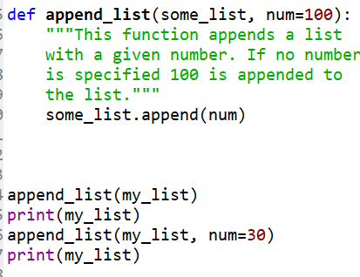
Installation of Python
Default Values
Arguments for functions can be made optional
A default value is specified
The default value can be changed by specifying it in the function call
Example: functions.py
In this example, the first time append_list is called num is not specified, so 100 is used. The second call specifies num to be 30.

Slide 9
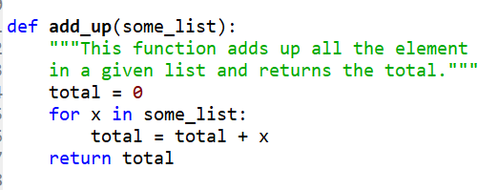
Doc Strings
Python documentation strings (or docstrings) provide a convenient way of associating documentation with functions.
Specified by using “”” ””” right after the function definition (def).
The docstring should describe what the function does, not (necessarily) how.
All functions should have a docstring

